Slide 1
Hydroxy compounds (Alcohols) Dr.Entssar Alshaway

Slide 2
Learning objectives
1-Define alcohol compounds
2- Naming alcohols
3- types of alcohols
4-preparation of alcohols
5- Reaction of alcohols

Slide 3
Alcohol
An alcohol is any organic compound in which a hydroxyl functional group (-OH) is bound to a carbon atom, usually connected to other carbon hydrogen atoms.
Alcohols are organic derivatives of water H-O-H in which one of the hydrogen atoms (H) is replaced by an alkyl group (R) R-O-H
General Formula: CnH2n+1 OH

Slide 4
TYPES OF HYDROXY COMPOUND
2 TYPES:
1-Aliphatic alcohol
2-Aromatic alcohol (phenols)

Slide 5
Aliphatic alcohol
1 -Select the longest carbon chain
that contains the -OH group.
2-Number from the end nearest -OH group.
3-Change the ending of parent alkane from -e to -ol. Use the number to show the location of OH.
4-Give the location and name of each substituent
(alphabetical order) as a prefix to the name of the main chain.

Slide 6
CH3─CH2─CH2─OH 1-propanol
3 2 1
OH
CH3─CH─CH3 2-propanol
3 2 1
CH3 OH
│ │
CH3─CH─CH2─CH2─CH─CH3 5-methyl-2-hexanol
1 2 3 4 5 6

Slide 7
When there are two or more –OH groups present, the name ends with diol, triol and so on.
OH OH
CH3 CHCH2 CHCH3 2,4-pentanediol
OH
C H3 CCH2OH 1,2,2-propanetriol
OH

Slide 8
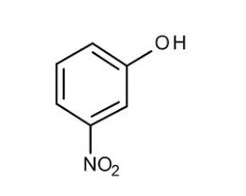
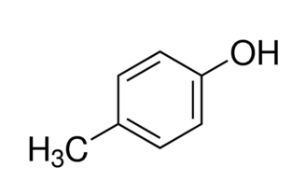
Aromatic alcohol
(phenols) In most cases, the name phenol is used as the parent’s name.
3-nitrophenol
4-methyl phenol

Slide 9
Types of Alcohols
1°,2° & 3° alcohols
primary alcohol (1°) – OH group attached to 1° carbon (eg: CH3CH2OH -ethanol)
secondary alcohol (2°) – OH group attached to 2° carbon (eg: 2-butanol) tertiary alcohol (3°) – OH group attached to 3° carbon (2-methyl-2-propanol)

Slide 10
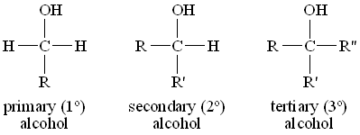

Slide 11
Preparation of Alcohols
Alcohols can be prepared by using 2 methods :-
a . Hydration of alkene
b. Fermentation

Slide 12
1-Hydration of Alkene
When we discuss the chemical properties of alkenes, we have learned that, when alkenes undergo addition reaction with water , alcohol will be produced.
C2H4 + H2O → C2H5OH
Ethene Ethanol
C3H6 + H2O → C3H7OH
Propene propanol

Slide 13
Fermentation
Fermentation is the chemical process which microorganism such as yeast act on carbohydrate to produce ethanol and carbon dioxide.
C6H12O6→2C2H5OH+2CO2
Glucose ethanol

Slide 14
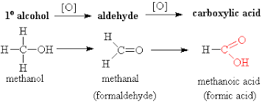
Oxidation of Alcohols: (1º), (2º )&(3º)
Oxidation of 1° Alcohols
In the oxidation [O] of a primary alcohol 1 , one H is
removed from the –OH group and another H from
the C bonded to the –OH and aldehyde is produced

Slide 15
Oxidation of 2° Alcohols
The oxidation of 2 alcohols is similar to 1 ,except that a ketone is formed.

Slide 16
Oxidation of 3° Alcohols
Tertiary 3 alcohols do not oxidize.
2-methyl-2-Butanol
no H on the C-OH to oxidize

Slide 17
Oxidation of Alcohols in our body
In biological systems, enzymes can induce oxidation of alcohol and /or the reduction of carbonyl compounds to alcohols. For example, in the liver, ethanol may be metabolized into acetaldehyde in the presence of the enzyme alcohol dehydrogenase. Blood alcohol concentration over 0.4% can be fatal.

